Slide 1

Department of Computer Engineering
IC 7490
BCD / Decade Counter
1

Slide 2
Points covered
Department of Computer Engineering
Introduction
IC Functionality : Verification
BCD / Decade Counter
MOD 6 Counter
MOD 20 Counter
2

Slide 3
Department Vision & Mission
Department of Computer Engineering
Vision
Achieve academic excellence through education in computing, to create intellectual manpower to explore professional, higher educational and social opportunities.
Mission
To impart learning by educating students with conceptual knowledge and hands on practices using modern tools, FOSS technologies and competency skills there by igniting the young minds for innovative thinking, professional expertise and research.

Slide 4
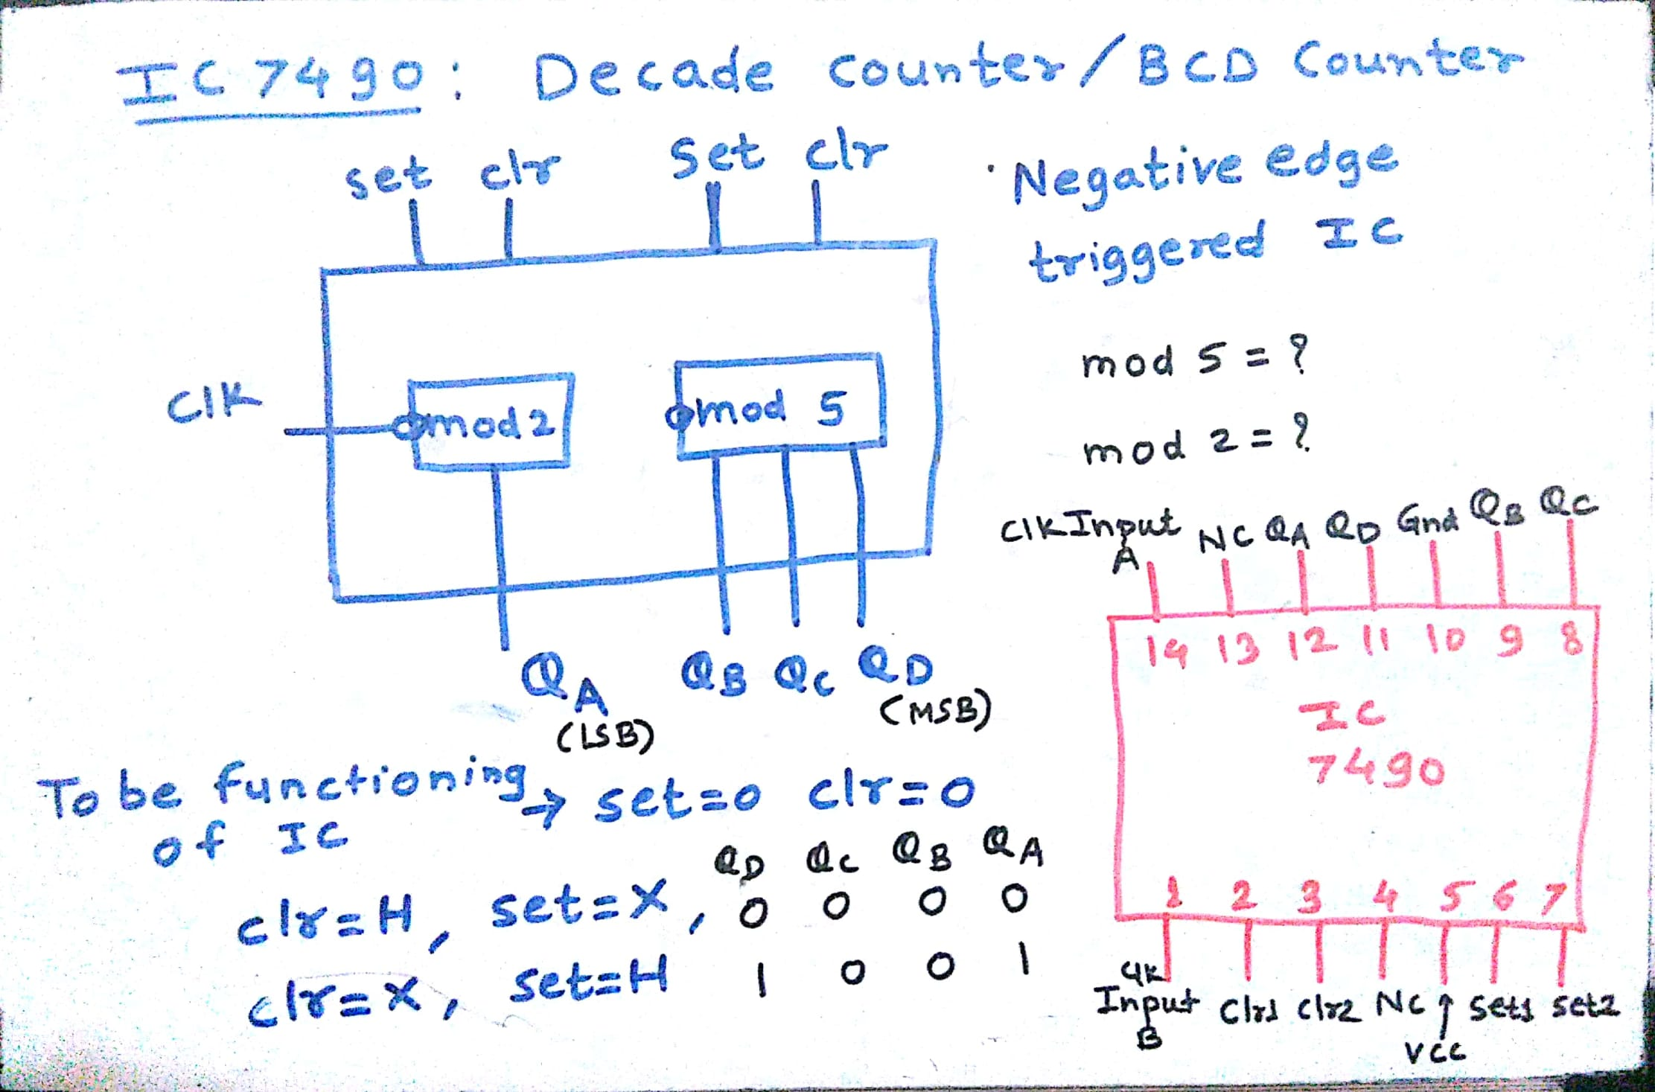
IC 7490
Department of Computer Engineering

Slide 5
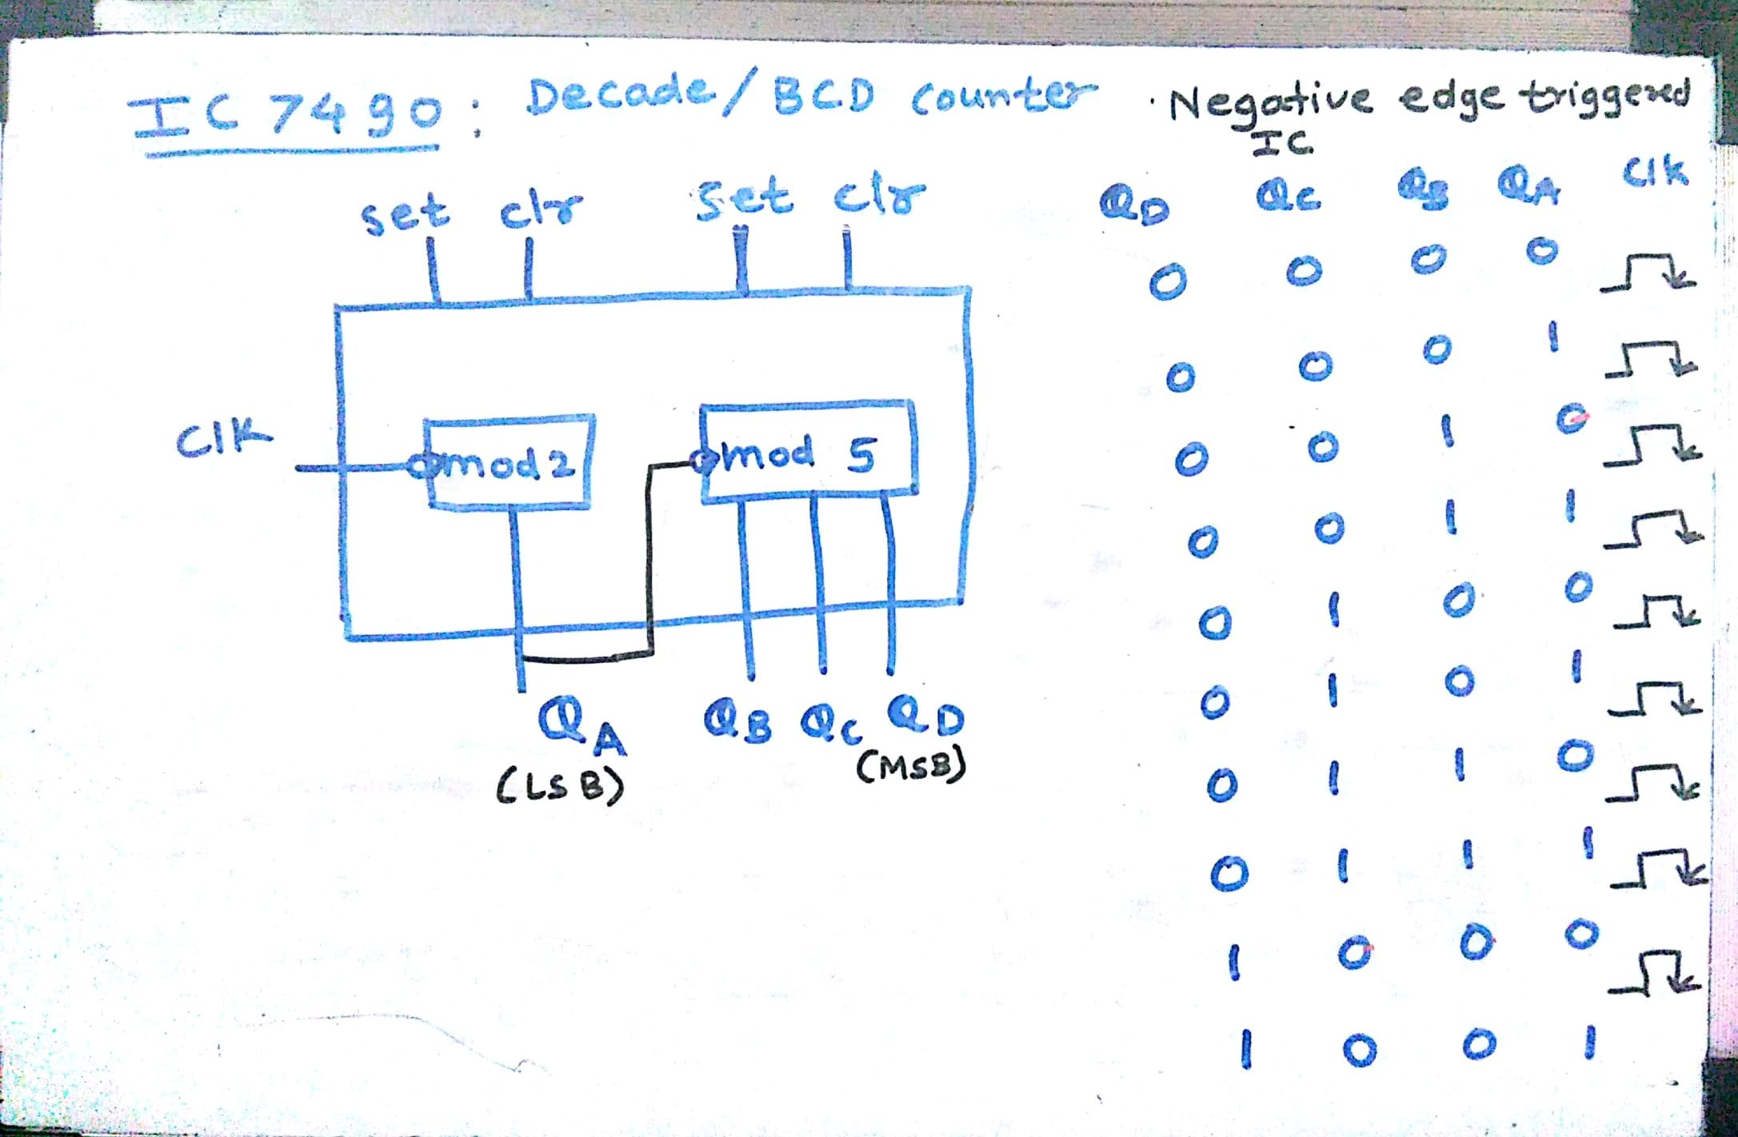
IC 7490 : Decade/BCD Counter
Department of Computer Engineering

Slide 6
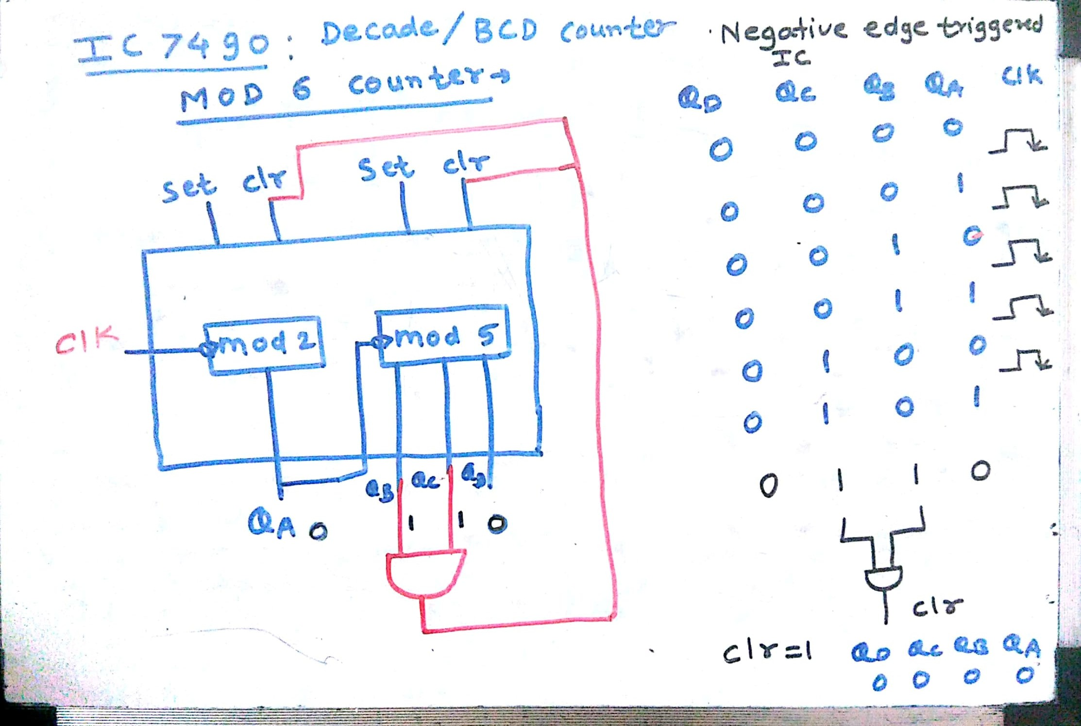
MOD 6 Counter
Department of Computer Engineering

Slide 7
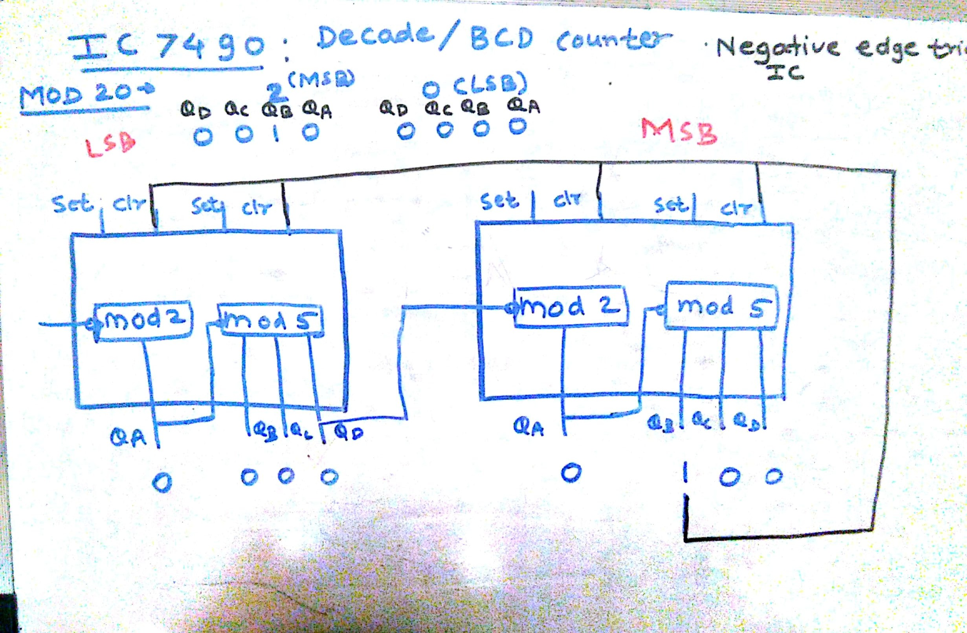
MOD 20 Counter
Department of Computer Engineering

Slide 8
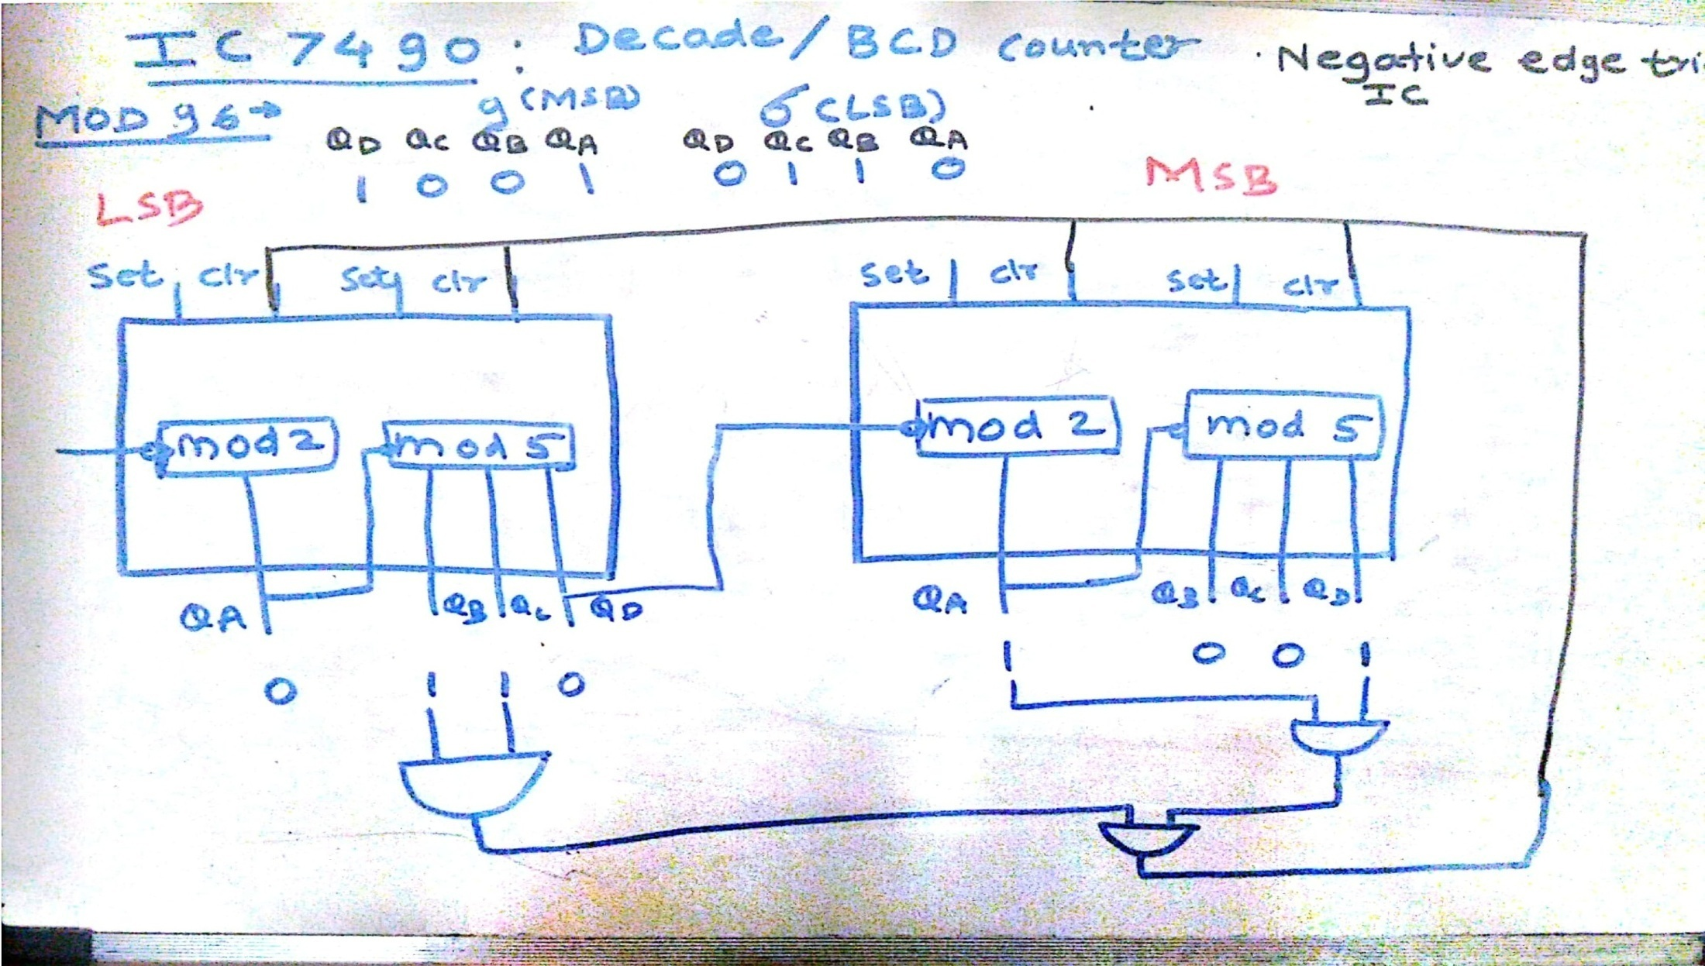
MOD 96 Counter
Department of Computer Engineering

Slide 9
Department of Computer Engineering
Thank you

